Slide 1

Introduction to CI/CD
CI ➔ Continous Integration
CD ➔ Continous Deployment/Delivery

Slide 2
What is Continuous Integration ?
Continuous Integration is a software development practice where members of a team integrate their work frequently, usually each person integrates at least daily - leading to multiple integrations per day. Each integration is verified by an automated build (including test) to detect integration errors as quickly as possible.
What?
Every developer commits daily to a shared mainline.
Every commit triggers an automated build and test.
Why?
Improve team productivity and efficiency
Find problems and solve them, quickly.
Release higher quality, more stable products.

Slide 3
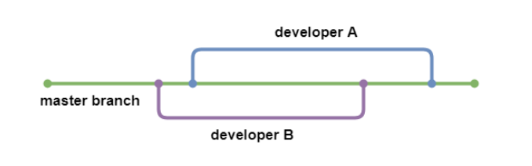
Git Branching

Slide 4
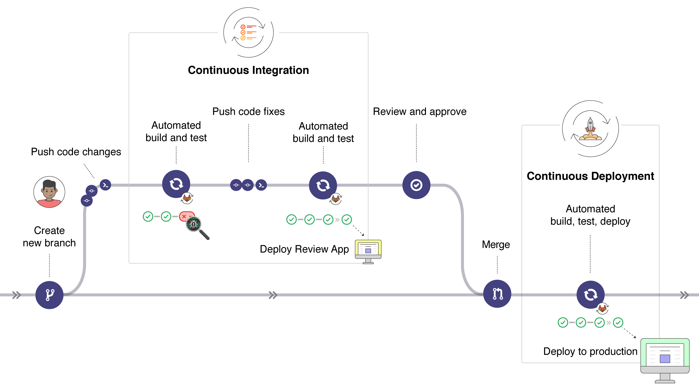

Slide 5

Continuos Integration (CI) Platforms

Slide 6
Continous Delivery and Deployment
Continuous Delivery: Your application is not only built and tested at every code change pushed to the codebase, but, as an additional step, it’s also deployed continuously, though the deployments are triggered manually.
Continuous Deployment: instead of deploying your application manually, you set it to be deployed automatically. It does not require human intervention at all to have your application deployed

